Slide 1

Sharks
Great White Shark

Slide 2
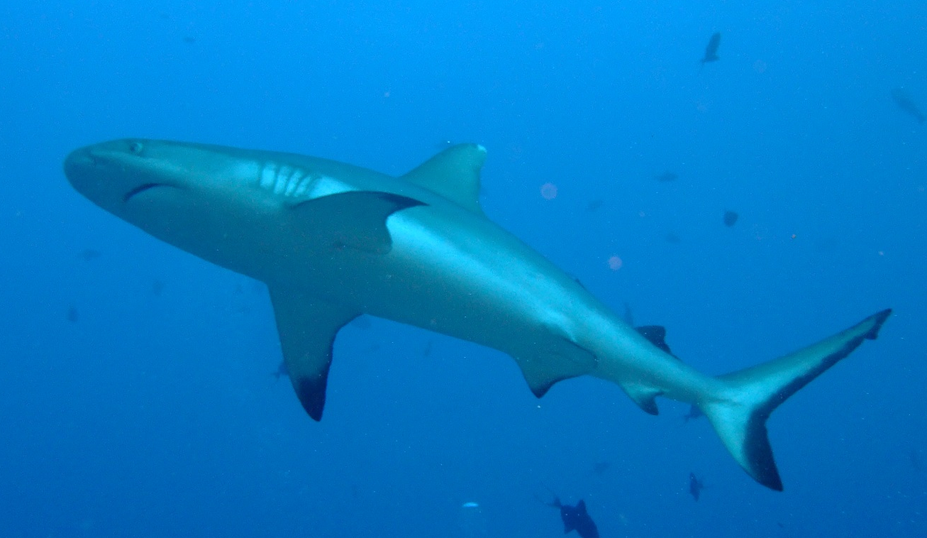

How much do you know about sharks?
Sharks are fish.
Sharks are streamlined.
Sharks have :
a cartilaginous skeleton
30,000 teeth
5 or 6 gills
Black Tipped Reef shark

Slide 3

Sharks & Bony Fish
 | SHARKS | BONY FISH
Skeleton Swimming Buoyancy (floating) | Cartilage only Can only swim forward. Large oily liver | Bones and cartilage Can swim forwards and backwards Gas-filled swim bladder
Gills Reproduction Skin | Gill slits but no gill cover Eggs fertilized in female's body. Rough, sandpaper-like scales | Covered gill slits Eggs usually fertilized in the water. Slippery, overlapping scales

Slide 4
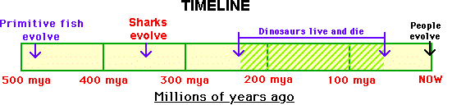
Sharks have existed for over 350 million years.
They evolved over 100 million years before the dinosaurs.
Notes:
Most fossil evidence of early sharks is from fossilized teeth and a few skin impressions.
Modern forms of sharks evolved during the Jurassic period, about 150 mya; this was the time of the giant dinosaurs like Brachiosaurus

Slide 5
Thriller movies show
sharks as nasty animals which regularly kill human beings,
but the truth is there are over 360 species of shark and very few are harmful.
You just need to be sensible if you plan to swim in an ocean where big sharks live.
Notes:
The truth is much less exciting or dangerous.
The chances of a shark attack are extremely low.

Slide 6
Most sharks ignore humans and swim past divers
These are Black Tipped Reef Sharks – and do not eat humans …
Can you see the Scuba Diver swimming behind them?

Slide 7
Sharks play an essential part in the ocean's balance by removing the weak and sick animals from the sea.
Tiger Shark

Slide 8
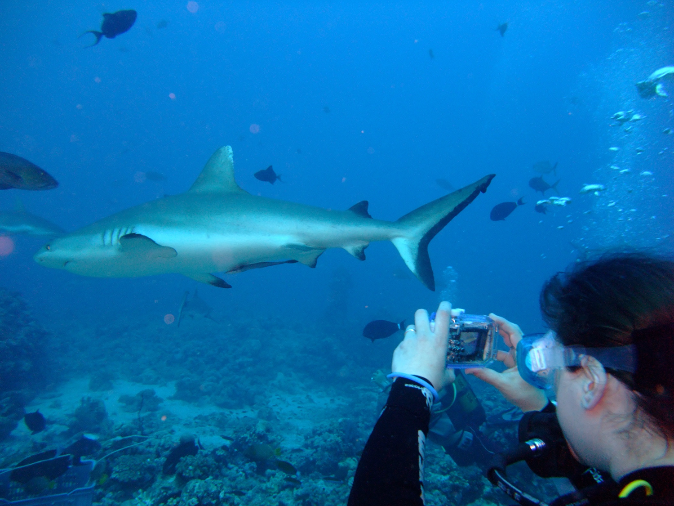
How do sharks breathe?
Sharks are fish who live in the sea – so they can’t get their oxygen from the atmosphere. Sharks have to absorb the oxygen from the water.
Sharks have gills at the side of their bodies which are openings where the water from the sea can flow through.
As the water goes through their gills, the oxygen in the water can be taken out and used by the shark to make energy for it to swim around.
Reef Shark

Slide 9
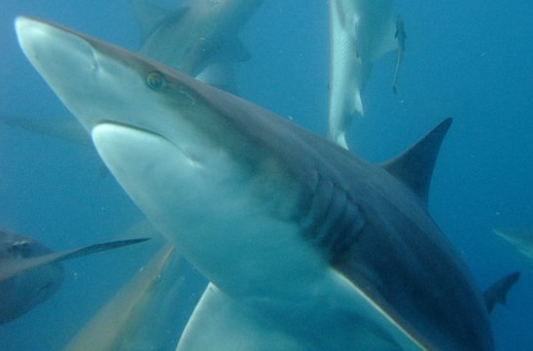
How good is a sharks sense of smell?
A shark has a very good sense of smell.
A shark can smell 10 drops of Tuna juice in a full sized swimming pool.
Blue shark
Notes:
A shark has a very good sense of smell.
A Lemon Shark could smell 10 drops of Tuna juice in a full sized swimming pool.

Slide 10
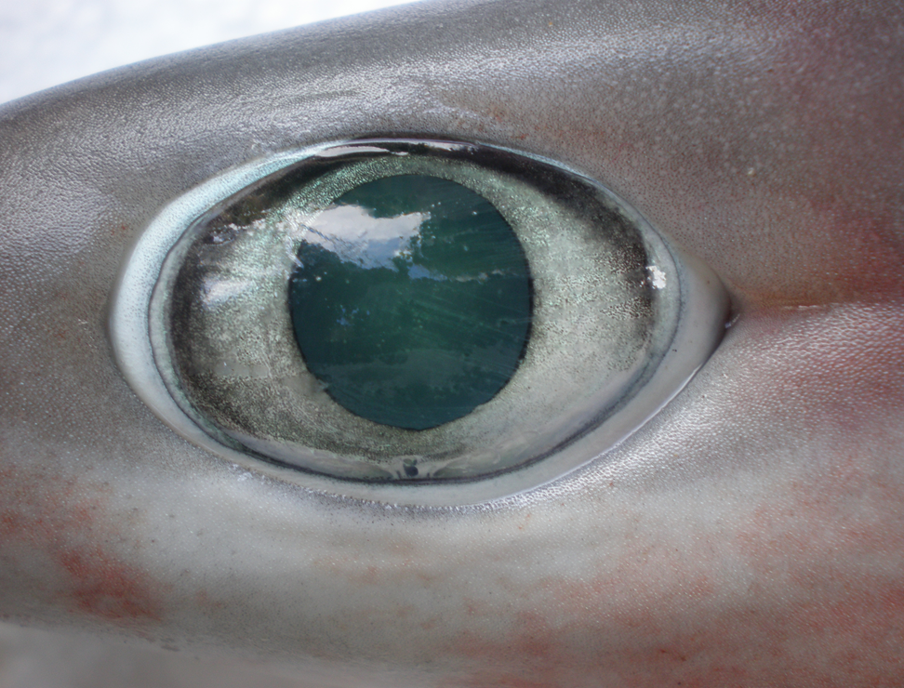
How well do sharks see?
Sharks have similar eyesight to humans – but have extra ability to see in the dark, as they often hunt for food at night time.
Notes:
Sharks have eyes very similar to humans, with rods, cones, cornea, iris, pupil, lens, and retina.
Scientists believe that sharks see colour the same way that we do except, being nocturnal, their eyes are 10 times more light sensitive than ours.

Slide 11
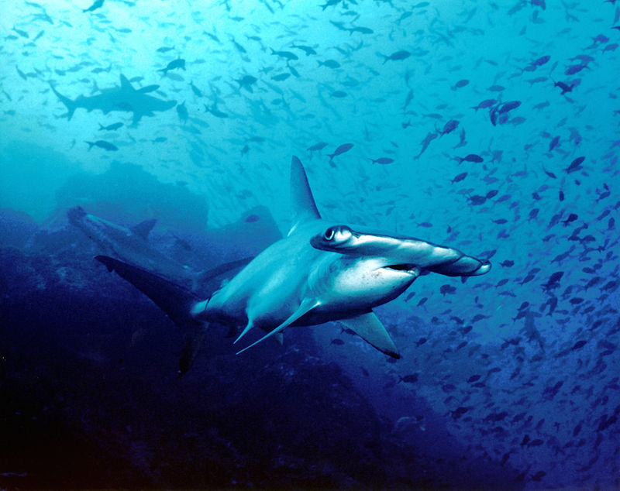
Hammerhead Sharks
Hammerhead Sharks have the best eyesight of all the sharks, as their eyes are positioned on the sides of their heads. As they sway their heads from side to side – they can even see what is behind them.

Slide 12
Sharks have a sixth sense that humans don’t have
Sharks have special organs at the front of their heads that can sense electrical signals – such as the heart beat of a flat fish lying hidden in the sand at the sea bottom.
It means that the shark can find food in the sand at night when it can’t see its food.
Bull shark
Notes:
The dark spots on the shark’s snout and lower jaw are pores that mark the opening of the ampullae of Lorenzini, jelly-filled canals that allow the shark to pick up weak electrical fields. Sharks use this sixth sense to find food, and to sense direction

Slide 13
Is a shark’s skin smooth?
No – shark skin is very rough. This picture is from a microscope and shows the skin ‘zoomed’ up close so you can see the details.
In olden days, when ships were made of wood and carved by hand – the ship builders would use shark skin as sandpaper.
Notes:
Instead of scales a shark has thousands of miniature ‘teeth’, called dermal
denticles embedded in its skin.
These skin teeth act as a suit of armour and provide protection for the shark. They make the shark’s skin so rough that years ago shark skin was used as sandpaper.

Slide 14
A shark can have up to 30,000 teeth in its lifetime.
Sharks lose their teeth when they bite into their food.
The next teeth in their jaws are then used.
When all the teeth are used – then the animal dies as it can no longer eat its food.
Mako shark
Notes:
A shark is always teething; it may lose between 12,000 and 30,000 teeth during its lifetime.
Its teeth aren’t attached to its jaws and are continually being replaced; it
is rather like having a conveyor belt of teeth.

Slide 15
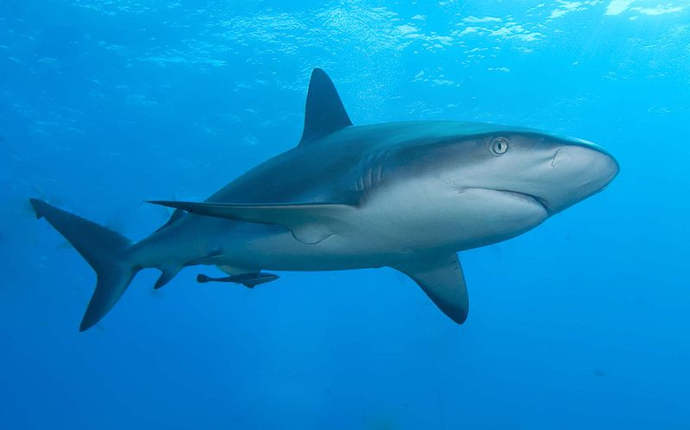
Conservation of Species
We need to protect and help sharks to survive.
Sharks are essential for the healthy balance of our oceans….
… and they are beautiful creatures.
Lemon shark

Slide 16
© Ocean World
A series of Oceanography Educational Materials
prepared by the WeirdFish Lady.
Visit the website: www.barnettauthor.co.uk

