Slide 1

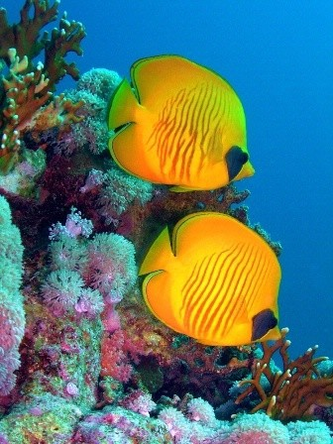
Ocean World

Slide 2

Planet Earth
What makes our planet so blue ?

Slide 3
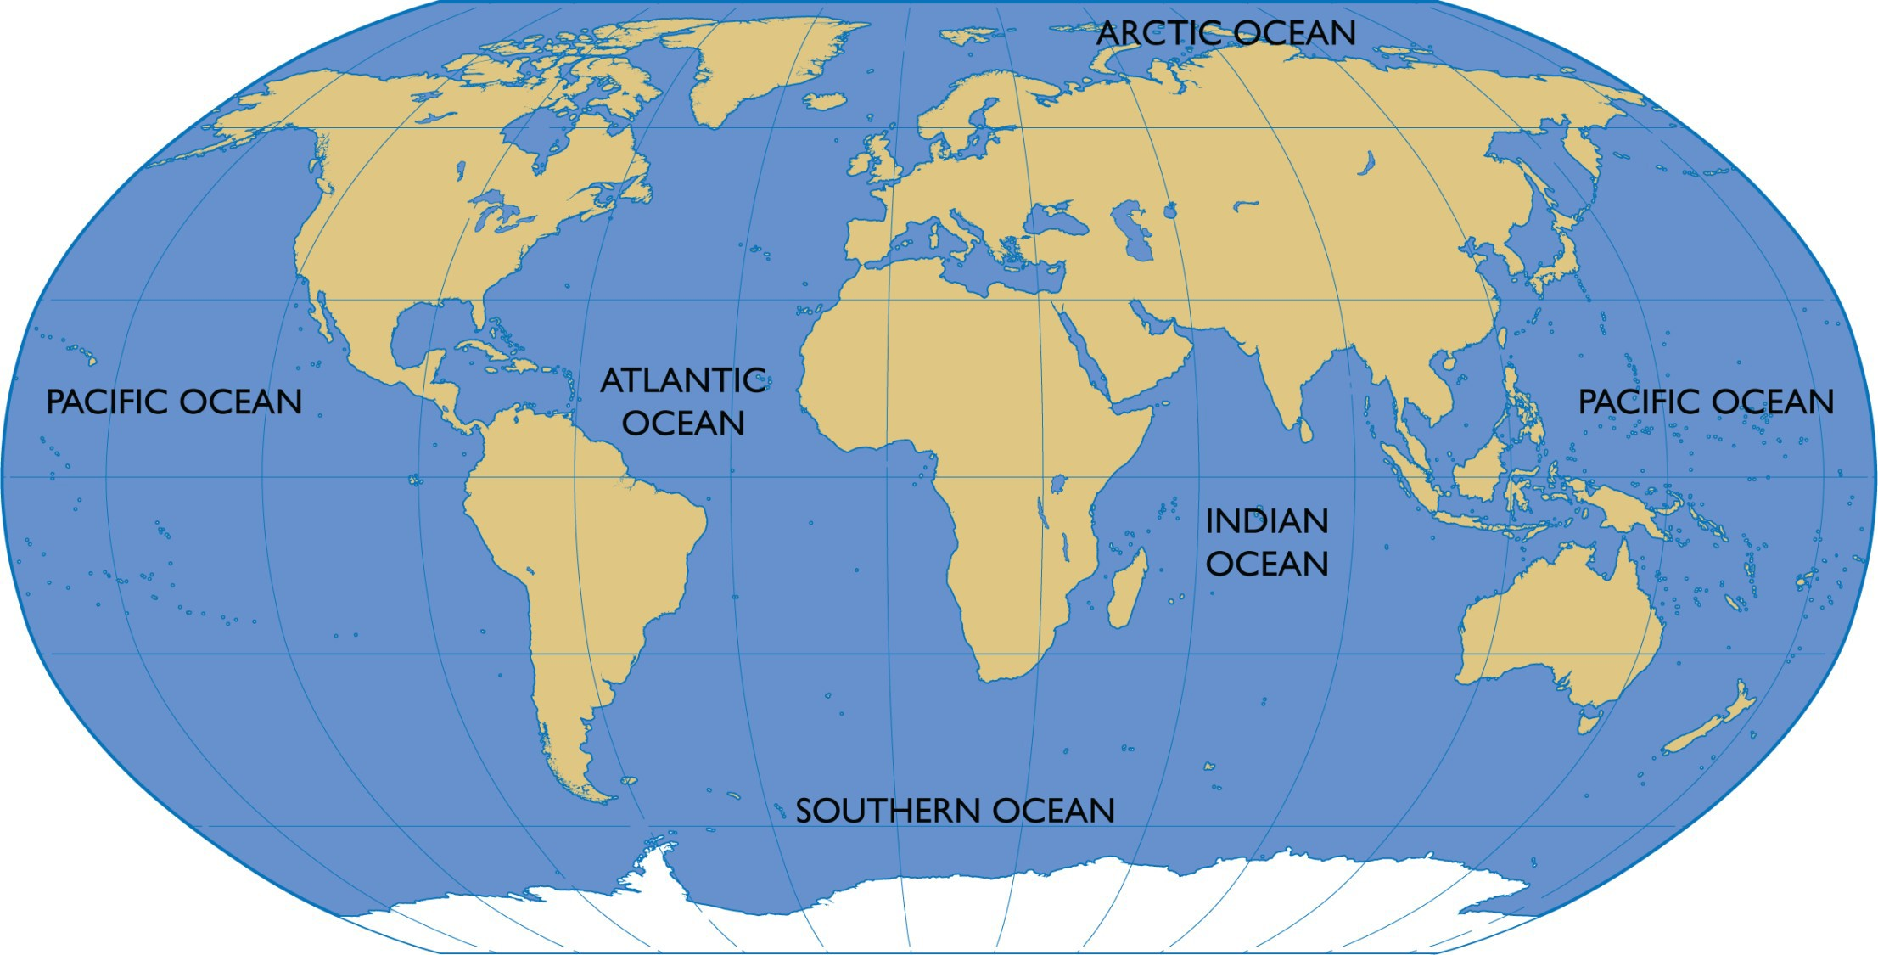
More water than land?

Slide 4
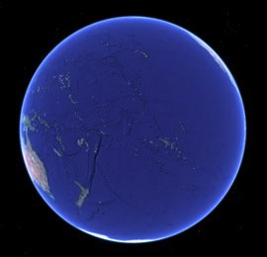
Pacific Ocean
The Pacific is the largest ocean on our planet and covers 46% of the Earth’s surface.

Slide 5
70% of the Earth is Ocean 30% is Land

Slide 6
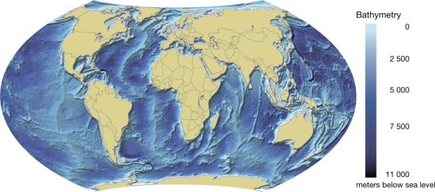
The darkest blue shows the deeper parts of the ocean

Slide 7
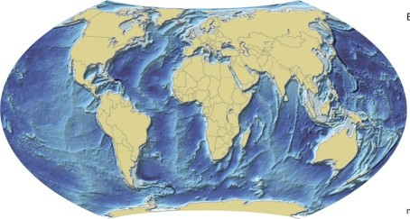
The deepest ocean is at 11 km down – at the Mariana Trench

Slide 8
Key Fact
So far humans have found
over 15,000 species of fish in the ocean, more than 210,000 of all marine species (fish, reptiles, mammals, birds)
… and we believe there are between 2 and 10 million yet to be found.

Slide 9
© Ocean World
Educational Materials prepared by
www.footprinttothefuture.co.uk

