Slide 1
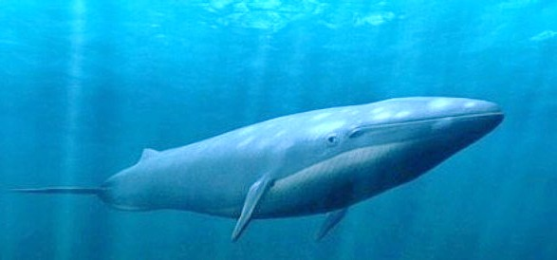
Giants in the Ocean

Slide 2

Blue Whale Facts
The largest creature ever to have lived on Earth, even bigger than the dinosaurs and it lives in our oceans NOW !
Tongue the size of an elephant, heart the size of a car, blood vessels you could swim through.
Can grow to 200 tonnes in weight, live for up to 90 years, and grow as long as 30 metres.
It’s a mammal not a fish – it’s warm blooded, and just like humans it gives birth to live young, and the females have mammary milk glands

Slide 3
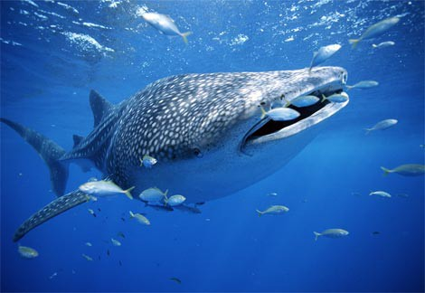
Whale Shark Facts
Largest living Fish – 18m
Evidence of existence from 60 million years ago
Lives to about 70 years old
Habitat: Deep, warm waters - worldwide
Filter Feeder. Swims with its huge mouth gaping open, filtering tiny plankton, algae and krill
The Whale Shark can circulate water through its gills, at a speed of up to 1.7 litres per second

Slide 4
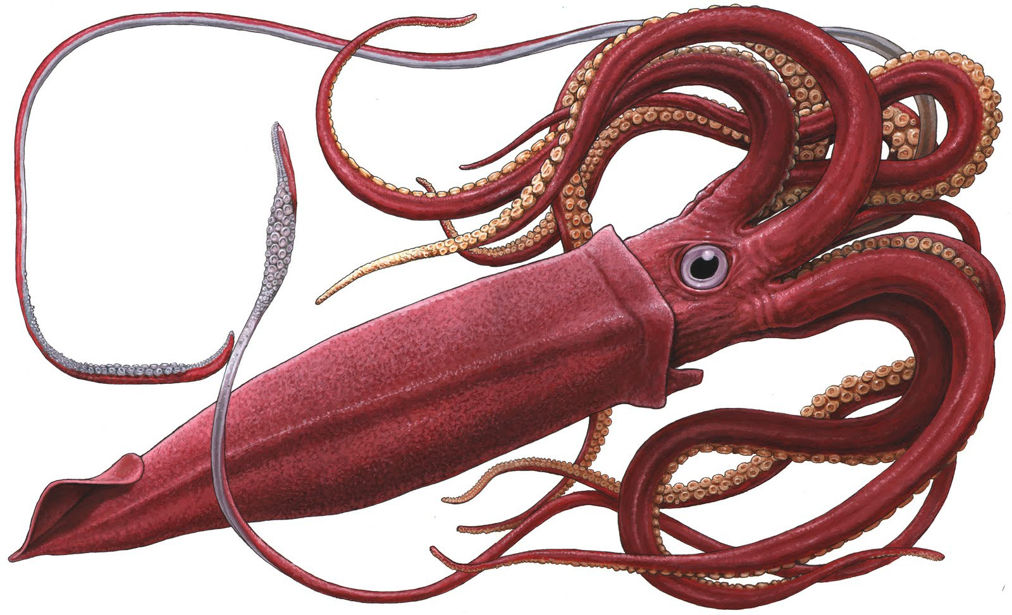
Giant Squid Facts
A member of the Octopus family
This creature is a cephlapod not a fish
It lives in the dark deep ocean
Its eyes grow as big as beach balls
It uses large tentacles covered with powerful suckers to catch its prey

Slide 5
© Ocean World
A series of Oceanography Educational Materials prepared by
www.weirdfishlady.co.uk

