Slide 1

Protecting the Oceans
Weirdfish Lady Study Materials – Protecting the Oceans

Slide 2
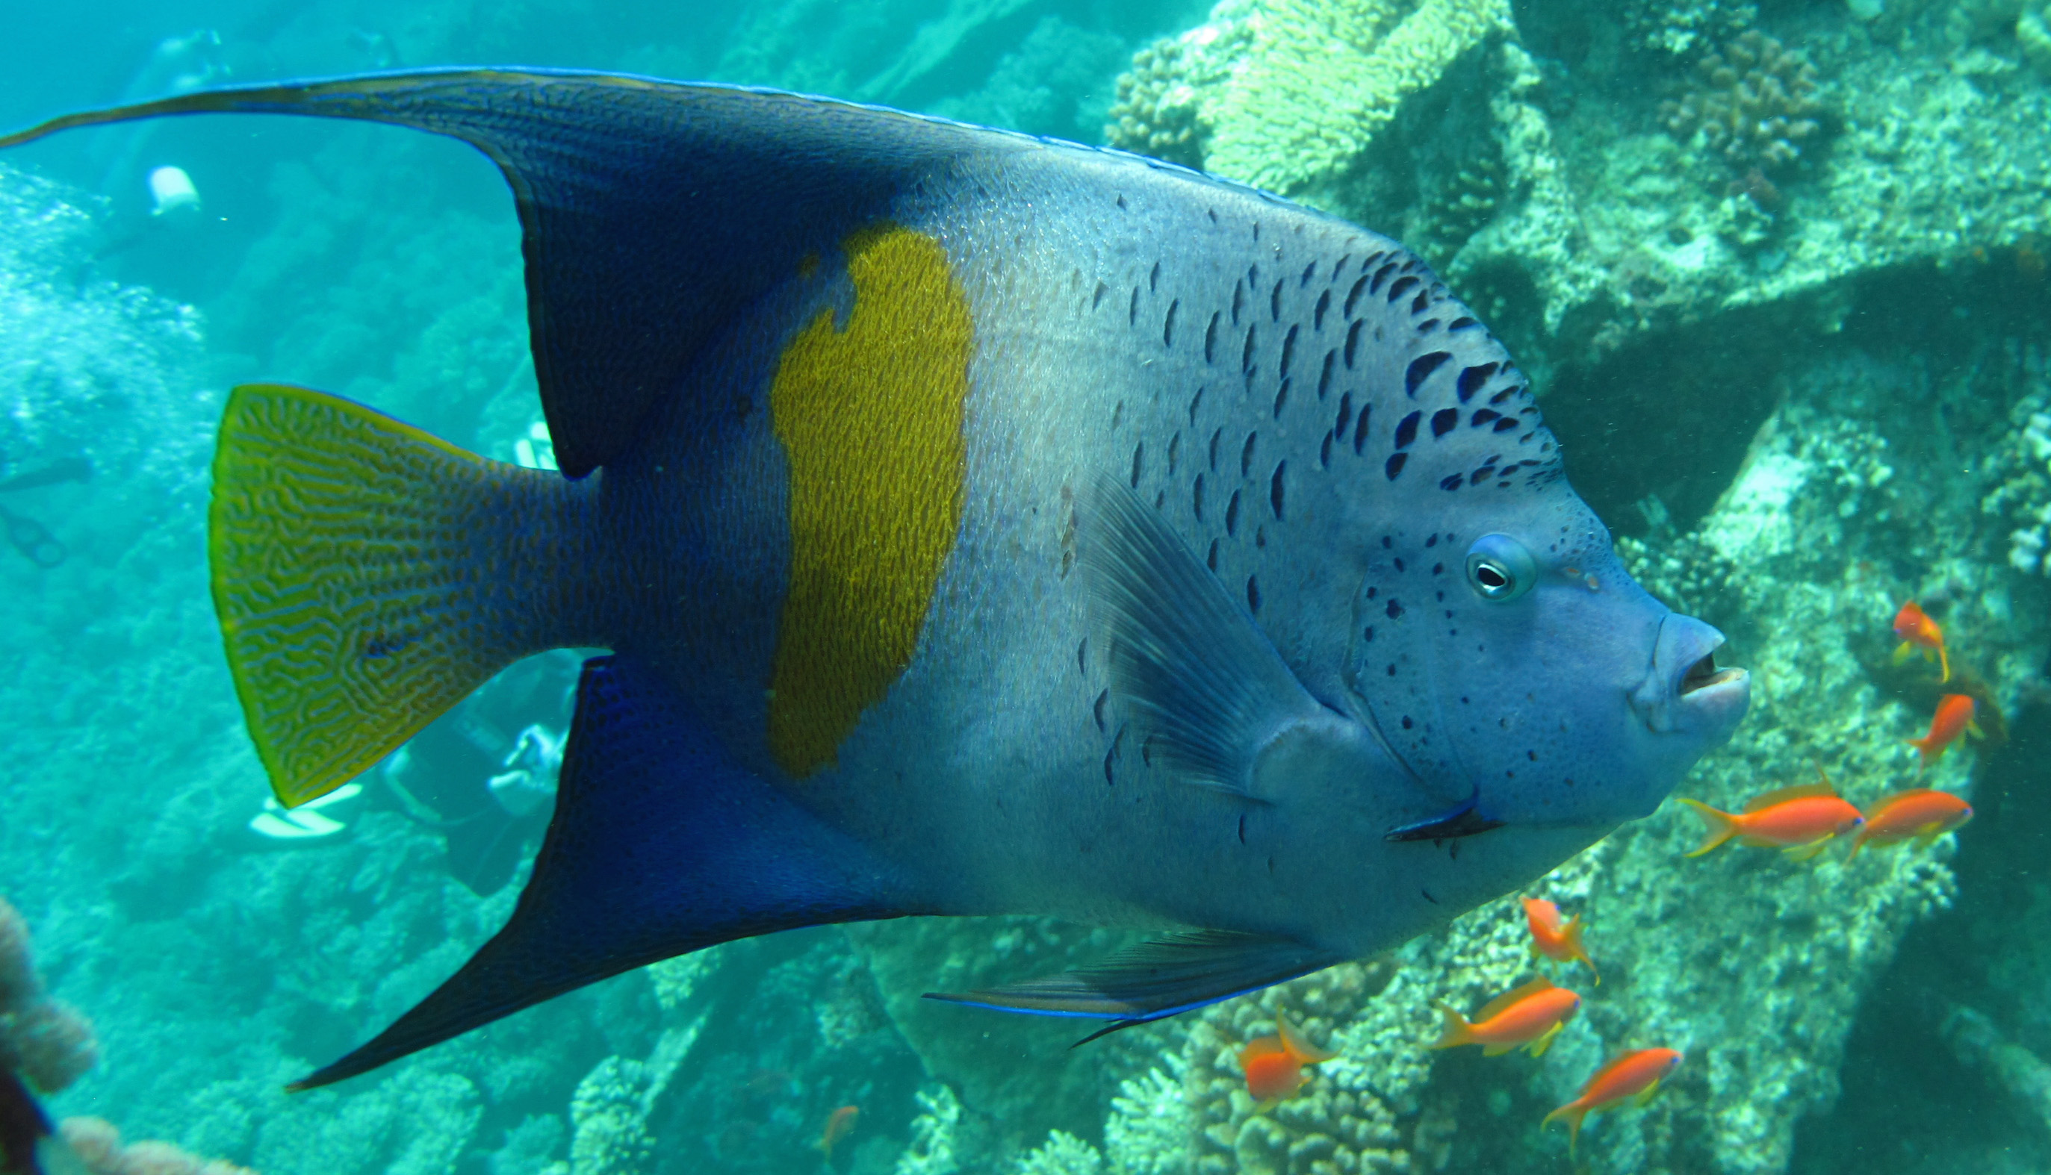
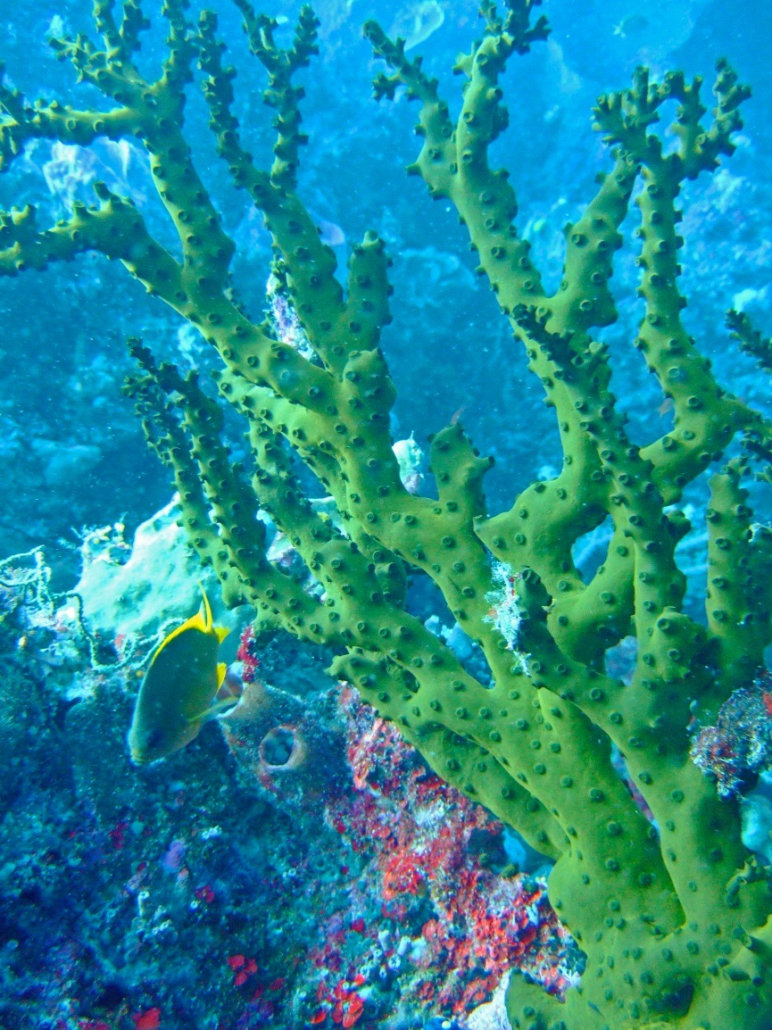
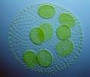
Why is the Ocean so special?
Plankton
Lives in the Ocean and produces
50 - 80% of Earth’s oxygen.
Ocean Creatures
65% of all animal species
live in the sea
Weirdfish Lady Study Materials – Protecting the Oceans
Notes:
Human population could not survive on just the oxygen produced by rain forests.

Slide 3
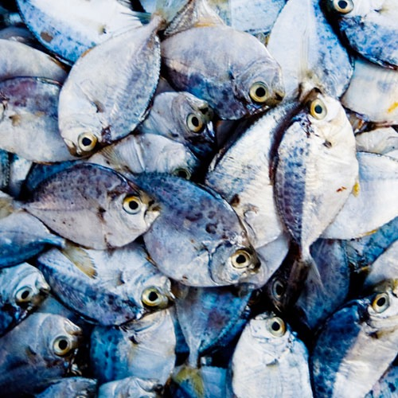
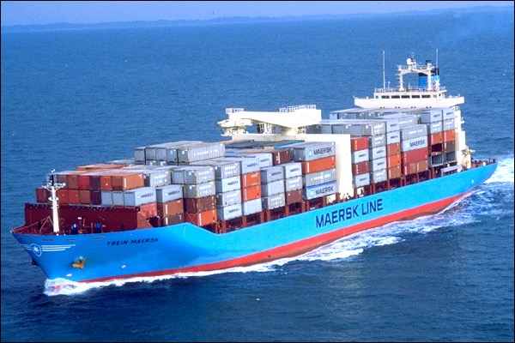
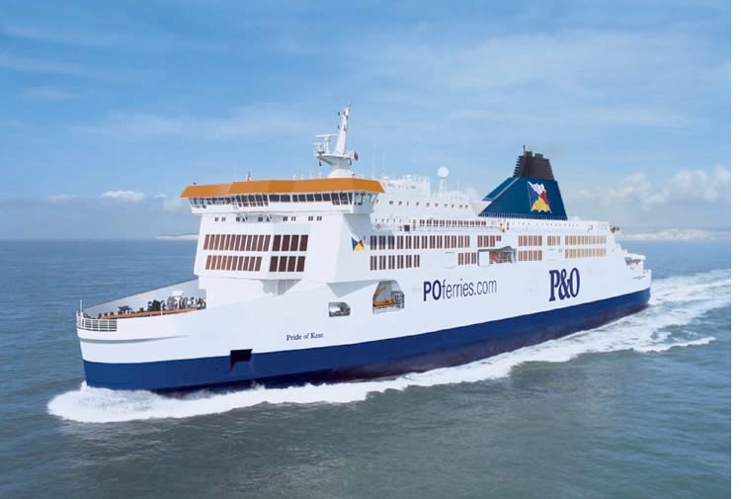
Why the Ocean is important to Humans
Food – protein source
Jobs – fishing to ferries
Transport – trade/economy
Weirdfish Lady Study Materials – Protecting the Oceans
Notes:
So lets look at Humans and our needs for the 7 billion people that now exist.

Slide 4
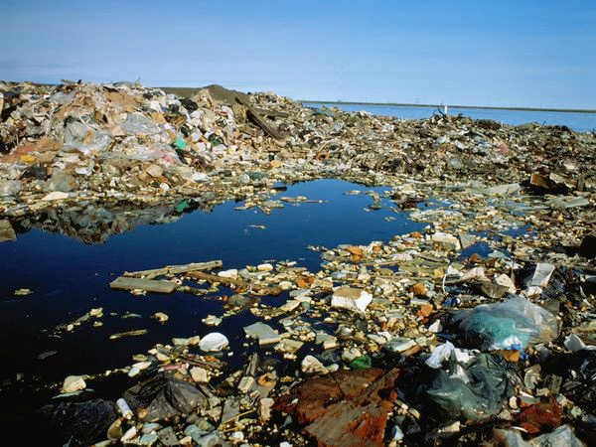
What damages the Ocean and the creatures which live there?
Plastic Waste
Sewage
Fishing Debris
Fishing Methods
Oil Pollution/Spills
Toxins
Sound Pollution
Ocean Acidity
Weirdfish Lady Study Materials – Protecting the Oceans
Notes:
4 main areas of pollution - for hundreds of years humans have been using the sea as a dumping ground -

Slide 5
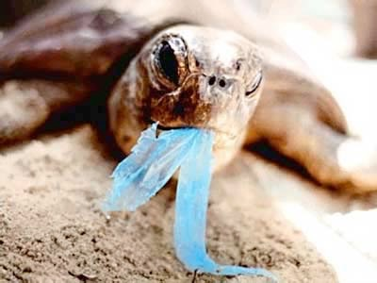
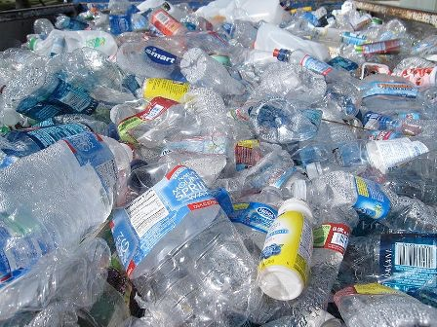
Plastic
Ingestion
Turtles, seabirds, marine mammals and fish mistake the rubbish for food.
How can we help?
Stop using plastic e.g. plastic bottles, straws, plastic bags, drinking cups, stop using toothpaste with microbeads. Clean the filture on the washing maching when washing fleeces.
Weirdfish Lady Study Materials – Protecting the Oceans
Notes:
It is the very properties that make plastics so useful, their stability and resistance to degradation, that causes them to be so problematic after they have served their purpose and these materials persist in the environment and are not readily degraded or processed by natural biological mechanisms.

Slide 6
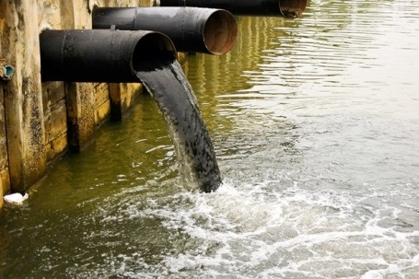
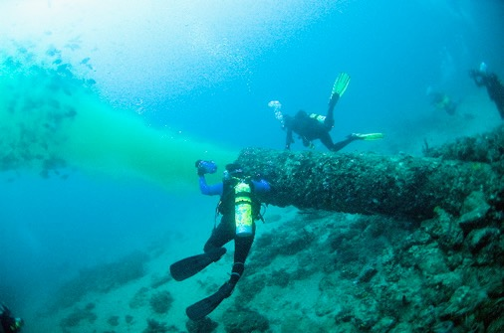
How can we help?
Dispose of litter carefully
Check sewage is treated before releasing it into the sea
Sewage related rubbish
from storm drains and sewer outlets carrying street litter to the Oceans
Weirdfish Lady Study Materials – Protecting the Oceans
Notes:
- it all ends up in the sea

Slide 7
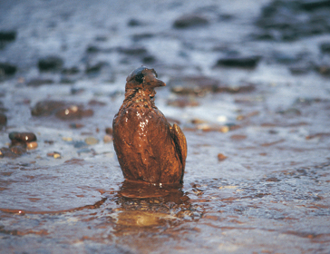
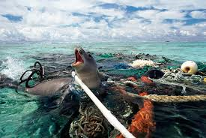
Fishing related rubbish
Oil Pollution
Commercial
Lines, nets, fishing pots.
Recreational Fishermen
Six-pack rings and bands from bait boxes
How can we help?
Dispose of rubbish carefully
Check there are no oil spillages
From boats or oil rigs
(Better still – find an alternative to using oil )
Weirdfish Lady Study Materials – Protecting the Oceans
Notes:
commercial fishing boats lose this stuff accidentally or by deliberately dumping into the ocean.

Slide 8
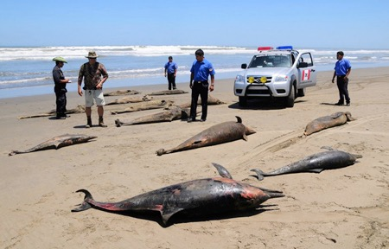
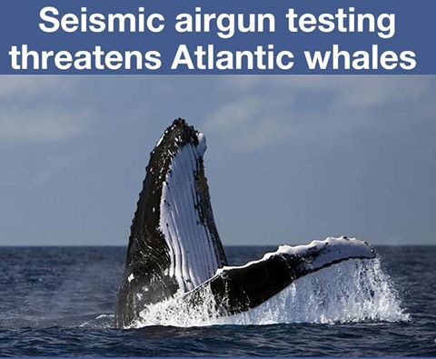
Excessive Noise in Oceans
Leads to ear damage in whales and dolphins and animals losing their navigational skills
How can we help?
Stop using seismic air guns to find oil
Use quieter engines in all shipping.
Weirdfish Lady Study Materials – Protecting the Oceans
Notes:
Beached whales - may be been put off course by such injuries.

Slide 9
Reduce Carbon Dioxide (CO₂) Emissions
Fossil Fuels emit CO₂ because they need to be burnt to provide energy. This is the process of combustion : -
Oxygen + Fossil Fuel = Carbon Dioxide + Water + Heat
Fossil Fuels are:
Coal
Oil
Gas
(Including Shale Gas)
Atmospheric CO₂ is absorbed by oceans all over the world and is turning the oceans acid – which is killing ocean creatures.
How can we help?
Reducing the use of Fossil Fuels will reduce the amount of carbon dioxide in the atmosphere.
Use clean energy such as solar power, wind and water energy
Weirdfish Lady Study Materials – Protecting the Oceans
Notes:
Fracking
People worry about chemicals in the water table.
The effects of possible earthquakes
Yet – no-one in any public debate that I have heard of yet – is stating what I think is the obvious
Why should we be drilling for yet more fossil fuel? When we need to change our energy policies and try to get zero emissions of CO2 – why are we bringing up more fossil fuel to burn to add to the CO2 excess already in our atmosphere.

Slide 10
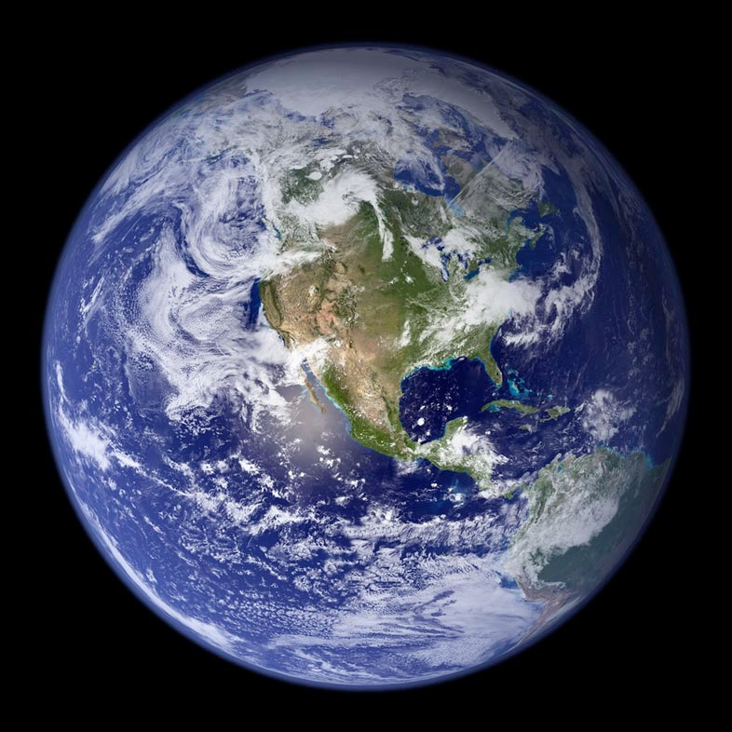
Look after Planet Earth and it’s Oceans
Fish is a great source of protein and fish stocks need to be protected from bad fishing practices such as deep water trawlers.
Keeping the Oceans clean of rubbish, oil, and sewage is essential
Keeping the Earth’s temperature low will reduce the damage from Carbon dioxide emissions – humans on Planet Earth must find alternatives to using Fossil Fuels.
Weirdfish Lady Study Materials – Protecting the Oceans

Slide 11
© Ocean World
A series of Oceanography Educational Materials
prepared by the WeirdFish Lady.
Visit the website: www.barnettauthor.co.uk

